Slide 1


Cell images prediction
Angela Dunston
Capstone Project – Three
Springboard Data Science Career Track (2024)

Slide 2
The Problem
Infectious diseases such as malaria & dengue are caused by parasites like viruses
Body cells infected with parasites called – Parasitized cells
Cells that are not infected called – Uninfected cells
These cell images can be captured using microscopes
“ Can we predict the infected and uninfected cells from microscopic images?”

Slide 3
Goals of the project
Labelling the two classes of images
Extracting the features using image processing
Training the images on a suitable neural network model
Predicting the test images using the final model

Slide 4
Data wrangling
Setting the path for images
Labelling the images
Converting to series and DataFrame
Shuffling the
DataFrame

Slide 5
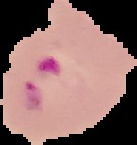
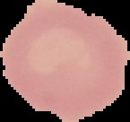
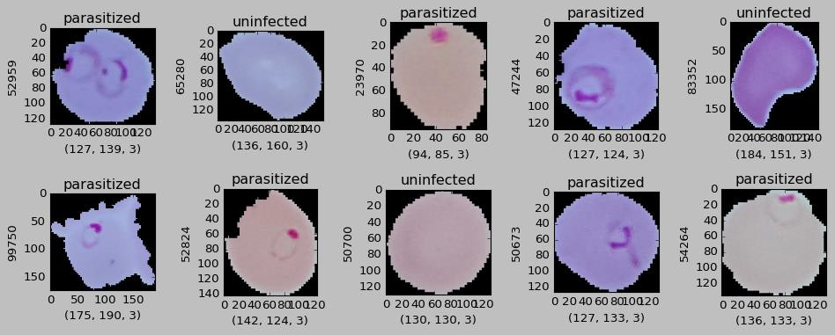
Exploratory Data Analysis
Image visualization
Images were labelled with two classes
Labelled images verified by matplotlib visualization
Parasitized cell
Uninfected cell
Image classes (binary):
0 – Parasitized
1 - Uninfected

Slide 6
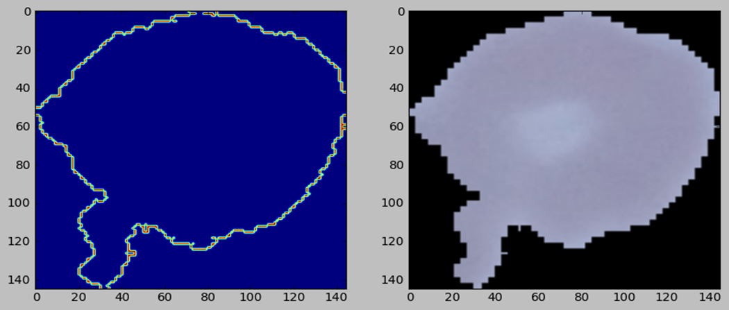
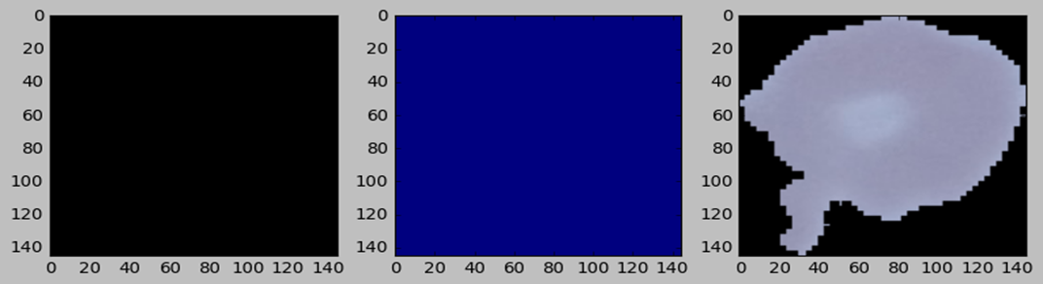

Extracting image features
Image edge detection
Image thresholding
Finding contours

Slide 7
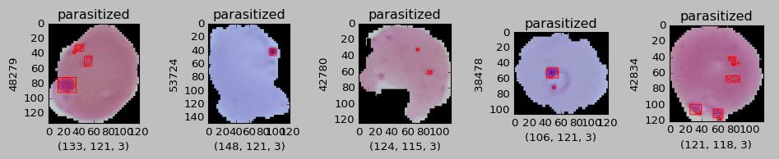
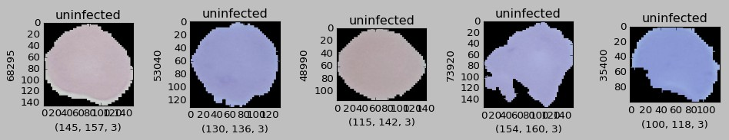
Applying features to the dataset
Parasitized set
Uninfected set

Slide 8
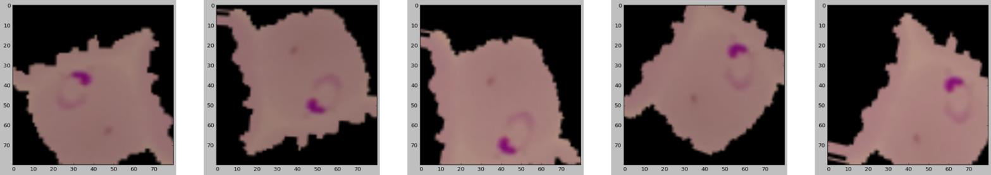
Preprocessing
Image augmentation
Generator Structure:
Keras Image Data Generator
Parameters used:
Rotation
Zoom
Brightness
Horizontal / vertical flips
Width / Height shift

Slide 9
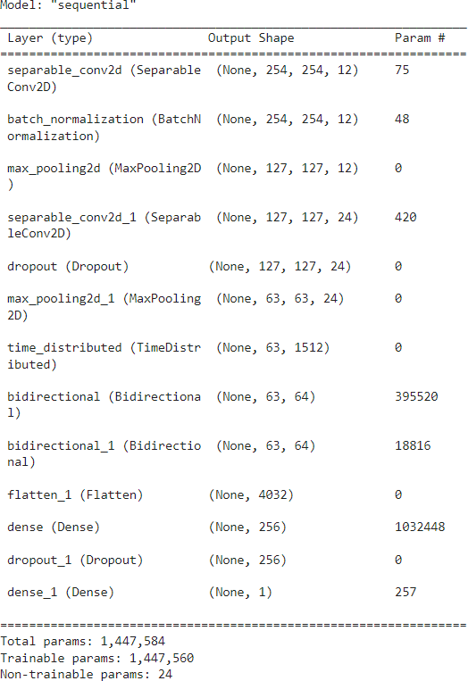
Modeling - Convolutional Neural Network (CNN)
Model Architecture
Model training
Performance metrics
Prediction

Slide 10
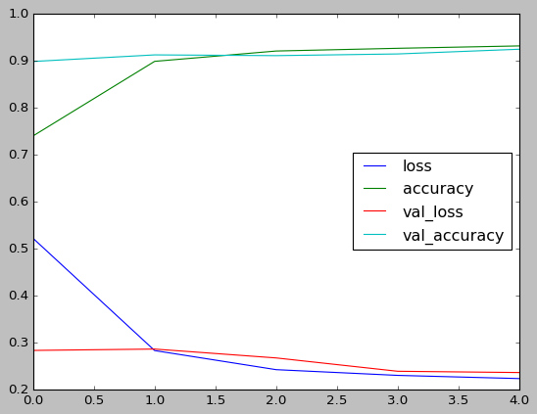
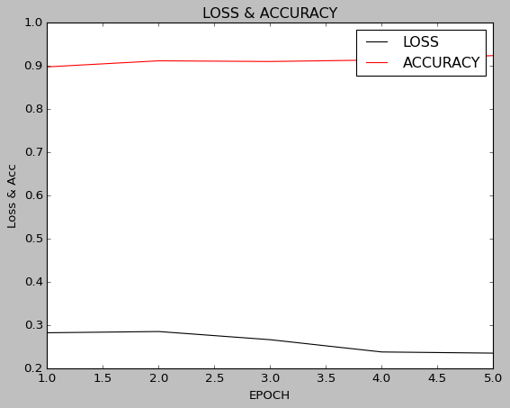
Model evaluation
Training vs validation
Loss & accuracy vs Epochs
 | Accuracy | Loss
Training image set | 0.50 | 0.71
Validation image set | 0.50 | 0.71
Test image set | 0.50 | 0.71

Slide 11
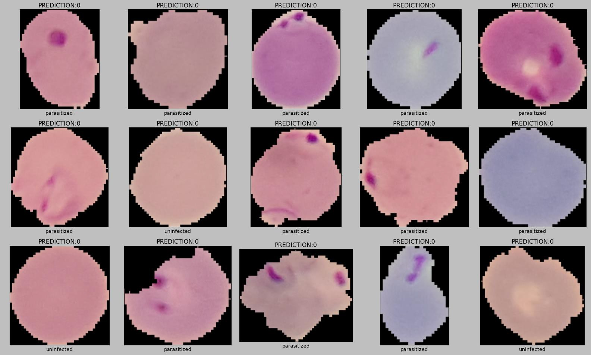
Prediction on test images

Slide 12
Additional Model evaluation (Torch CNN/AlexNet)
 | Accuracy | Loss
Torch CNN | 0.94 | 0.06
AlexNet | 0.94 | 0.06

Slide 13
Summary
Original CNN model did not successfully classify the cell images classes
Low accuracy (50%) and randomized loss (0.71) obtained
Many images may have been misclassified
Other models were tested for model comparison study to increase accuracy and minimize loss.
CNN Torch and AlexNet Models were tested. Accuracy was improved to 94% for both models. Image classification was successful with minimum loss.

